Slide 1

Oracle JavaScript Extension Toolkit Web Components Bring Agility to App Development
Lucas Jellema, CTO of AMIS
Oracle OpenWorld 2018, San Francisco, USA
Notes:
In this session learn how Oracle JavaScript Extension Toolkit composite components enable a higher level of productivity, agility, and maintainability of rich client web applications. The reusable components can be shared across pages, applications, and teams—and even across the global community. The components can be developed separately from the applications that consume them and can be deployed and updated independently. They are also well-suited to be used as the user interface for a microservice that is mashed up in a larger web application or portal. Learn the why and how of Oracle JavaScript Extension Toolkit composite components, tooling to use for productivity and agility, and a proven approach for microservice UI implementation.

Slide 2




Lucas Jellema Architect / Developer 1994 started in IT at Oracle 2002 joined AMIS Currently CTO & Solution Architect
Developed applications with Forms, Mod PL/SQL (Database), ADF, JET, …

Slide 3

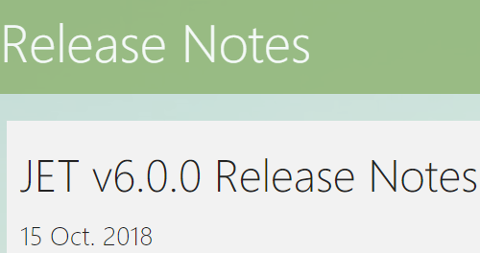
I suffer from JET lag…
(my demos are on JET 5.2, not yet 6.0)

Slide 4
Overview
Leveraging JET Web Components (fka JET Composite Components)
Introducing the JET WebComponent Manager
Automated injection of components at design time and run time
JET WebComponents and Microservices
Decoupled development and Build time or Run Time composition
Creating a JET WebComponent – the InputCountry component
Sharing JET WebComponents
Exchange
Use JET WebComponent in Visual Builder Cloud
What’s next?

Slide 5
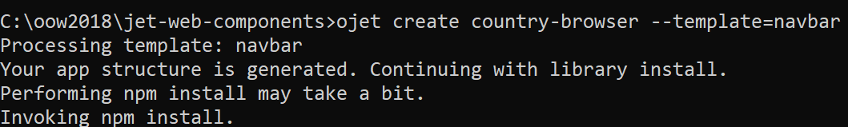
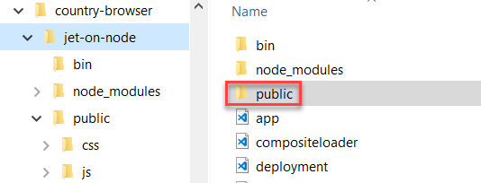
Demo - preparation
Create fresh new JET application
Copy in a Node application skeleton for runtime serving

Slide 6
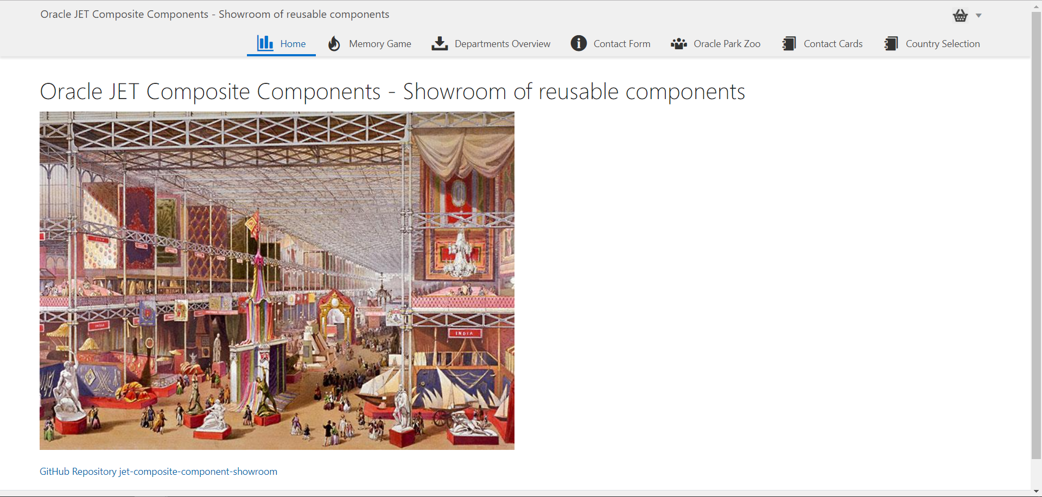
Notes:
https://github.com/lucasjellema/jet-composite-component-showroom

Slide 7
Introducing JET WebComponents

Slide 8
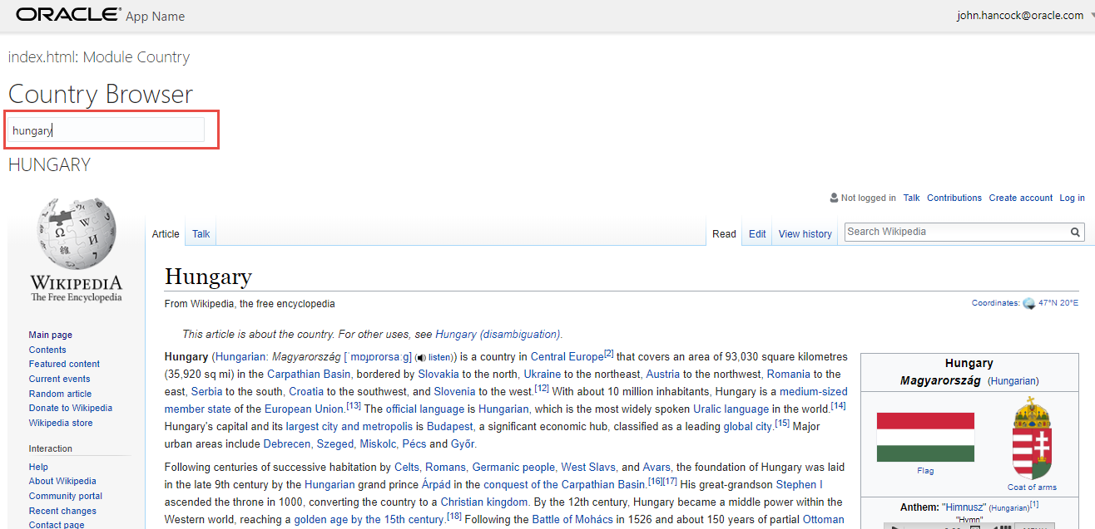
Country Browser - with room for UX improvement

Slide 9
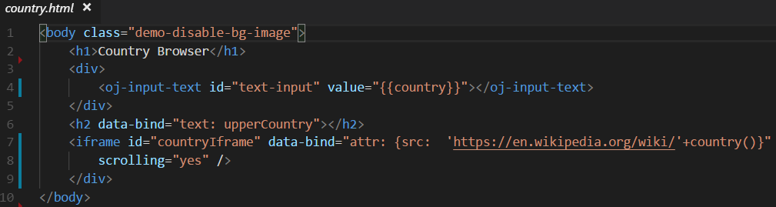
Country Browser - with room for UX improvement

Slide 11
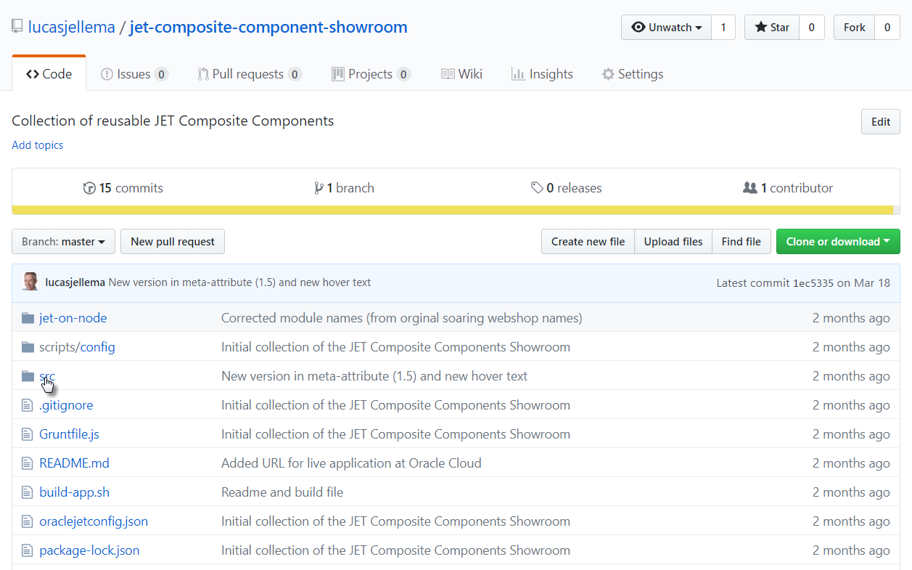
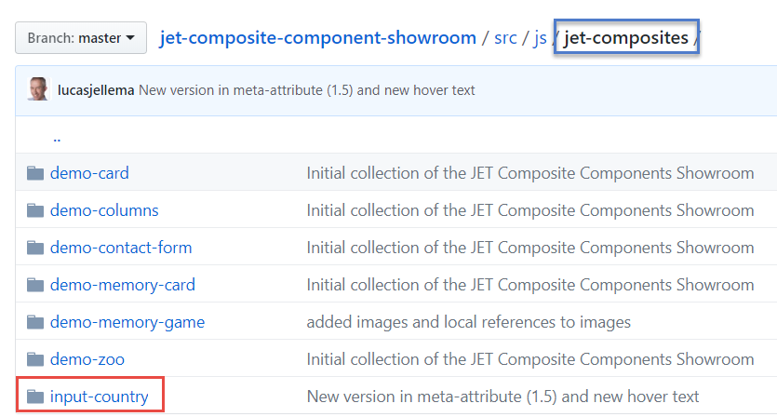

Slide 12
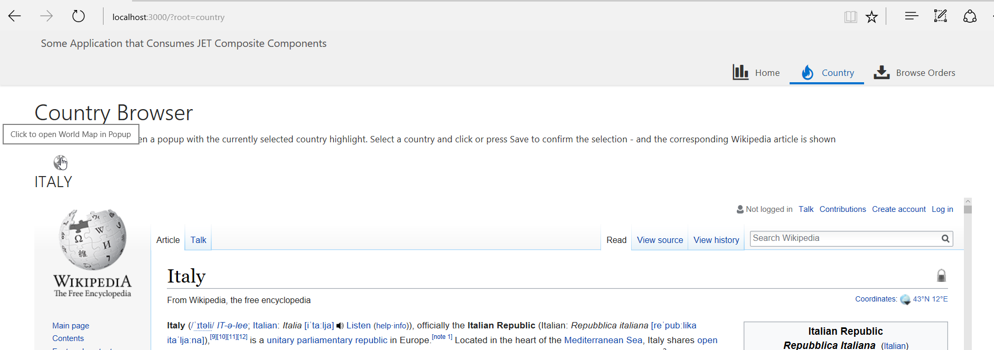
Wikipedia Country browser powered by JET Web Component
Notes:
hhhhhhhhhhhhh6hhhhhhhhh6hh6h6h6hhh6hhhh6hhhhh6hhh66h66hhh6h6h6hh66hh6h

Slide 13
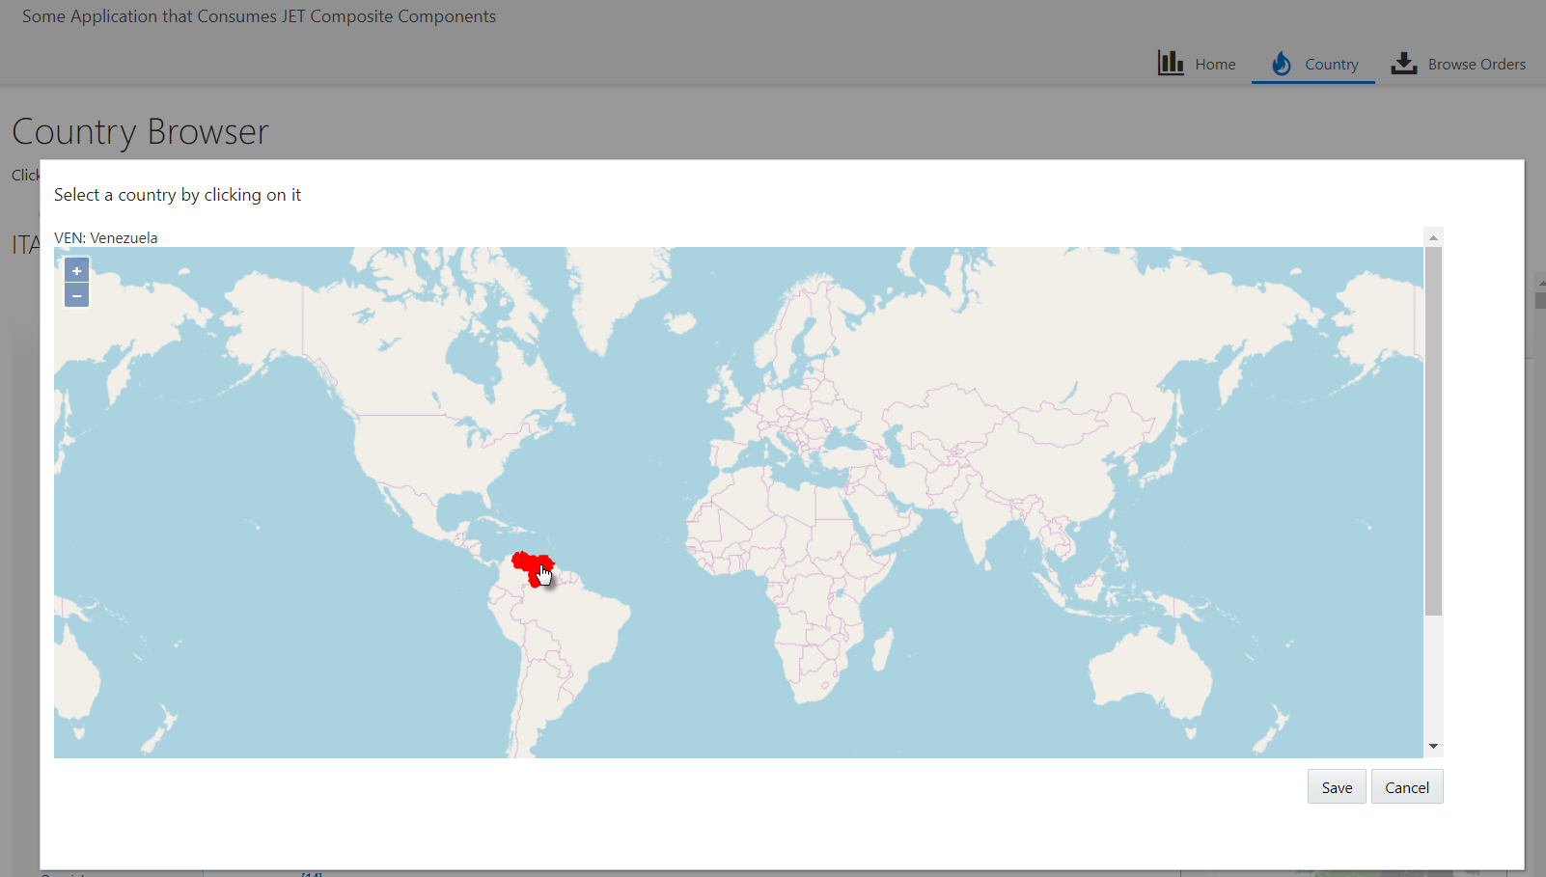
Click on country and select another country to inspect in Wikipedia

Slide 14
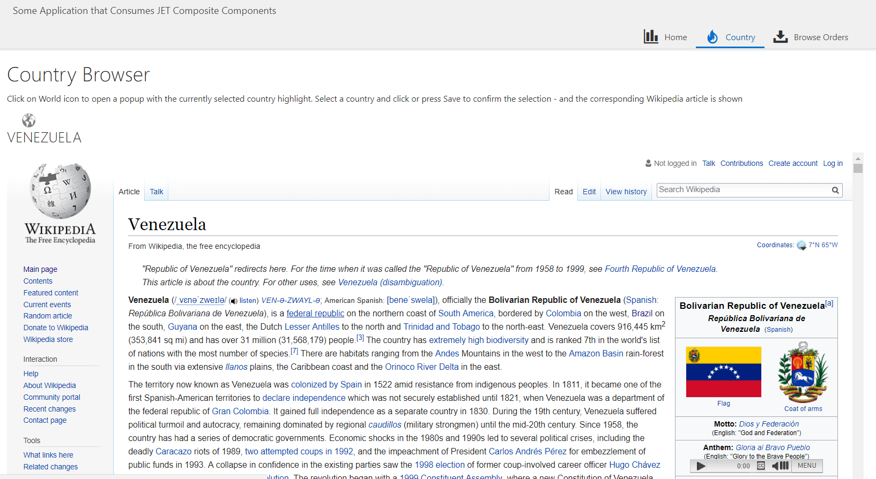
Wikipedia details for newly selected country are shown in an IFRAME

Slide 15
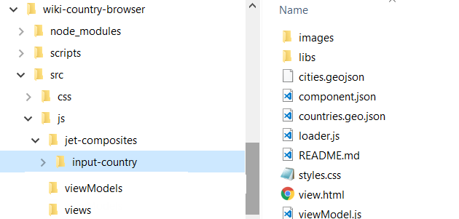
Copy JET Web Component into application

Slide 16
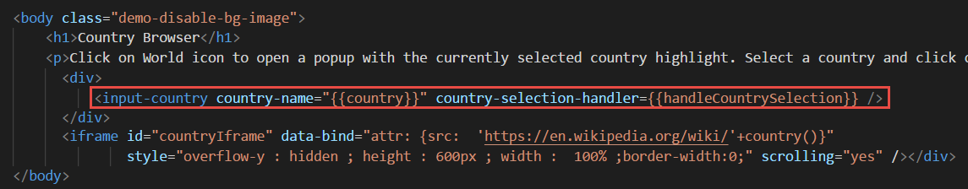
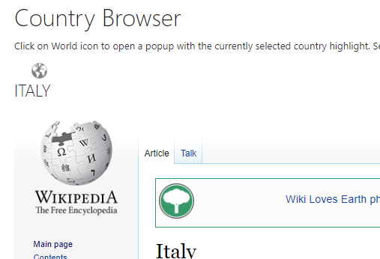
Embedding input-country component in view:

Slide 17
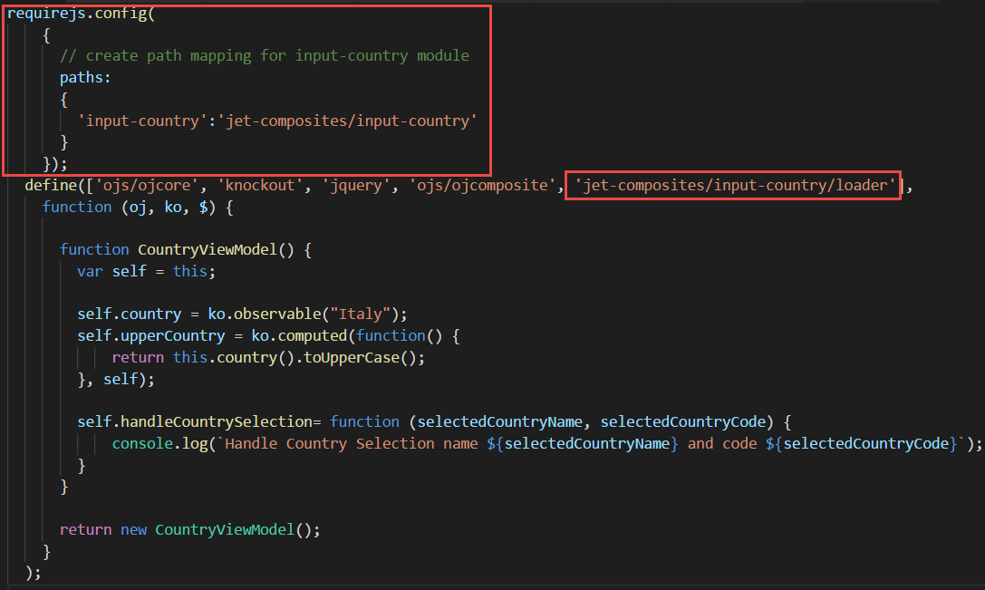
ViewModel – require & define to hook component into page

Slide 18

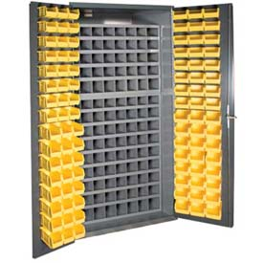

Beauty of Composite Components
Notes:
Share & Reuse
Internally within an application as well as throughout organization
Externally across the community
Compartmentalize development effort – make smaller, stand alone pieces
Micro….
Bonus: low code extension

Slide 19
Introducing JET Web Component Architecture (JWCA): “A JET Web Component is a reusable piece of UI that can be embedded as a custom HTML element and can be composed of other JET Web Components, JET components, HTML, JavaScript, and CSS.”
Notes:
http://www.oracle.com/webfolder/technetwork/jet/jetCookbook.html?component=composite&demo=basic

Slide 20
JET Web Component
A reusable building block – encapsulated with a well defined interface
Created using HTML, CSS, JavaScript, JET resources, other JET Web components
Packaged in a Zip file that can be shared with any application and any team
Easily ‘injected’ into a JET application
copy contents of zip-file to specific directory
And easily used in a page
Add tag to View
Load module in ViewModel
JET WC
InputSmiley
My JET Application
Your JET Application
Page 1
Page 2
JET WC
InputSmiley
JET WC
InputSmiley
Page A
Page B
<input-smiley>
<input-smiley>
<input-smiley>
<input-smiley>
<input-smiley>
<input-smiley>
<input-smiley>

Slide 21
Introducing the JET WebComponent Manager
Managing dependencies on JET Web Components at design | build | deploy | run | request time

Slide 22




Referencing JET Web Components
Meta data file describing JET Web Components used in a JET application and to be managed by jwcm. Located in src/js/jet-composites
Name
Version (min/max)
Git tag/commit/branch
URL (zip, Git Repo, Live JET app)
Phase (design, build, deploy, run, request
Command Line Interface that is run for a specific phase (install, build, deploy, run, request) reads jet-composites.json and fetches JET-Composites as required – storing them in /src/js/jet-composites/<name of component>
jet-composites.json
Locations from where JET Composites can be retrieved: - Git (incl GitHub and BitBucket) - the JET Web Components showroom
- Live JET Application
- A zip-file at a URL
jwcm
(JET WebComponent Manager CLI)
Design/Install time
Build time
Deployment time
Run time
Request time
Use jwcm install to fetch composite components and save in application
Before/ at the start of ojet build, use jwcm to add in Composite Components
After launching node, fetch composite components and write to local file system before starting to serve JET application
Manual, scheduled or WebHook trigger (e.g. from Git) to (re-)fetch the source of the composite component and write to local file system
Any request for artefacts of the JET Web Component is redirected – the artefact is fetched live from a specified location (possibly with caching)

Slide 23
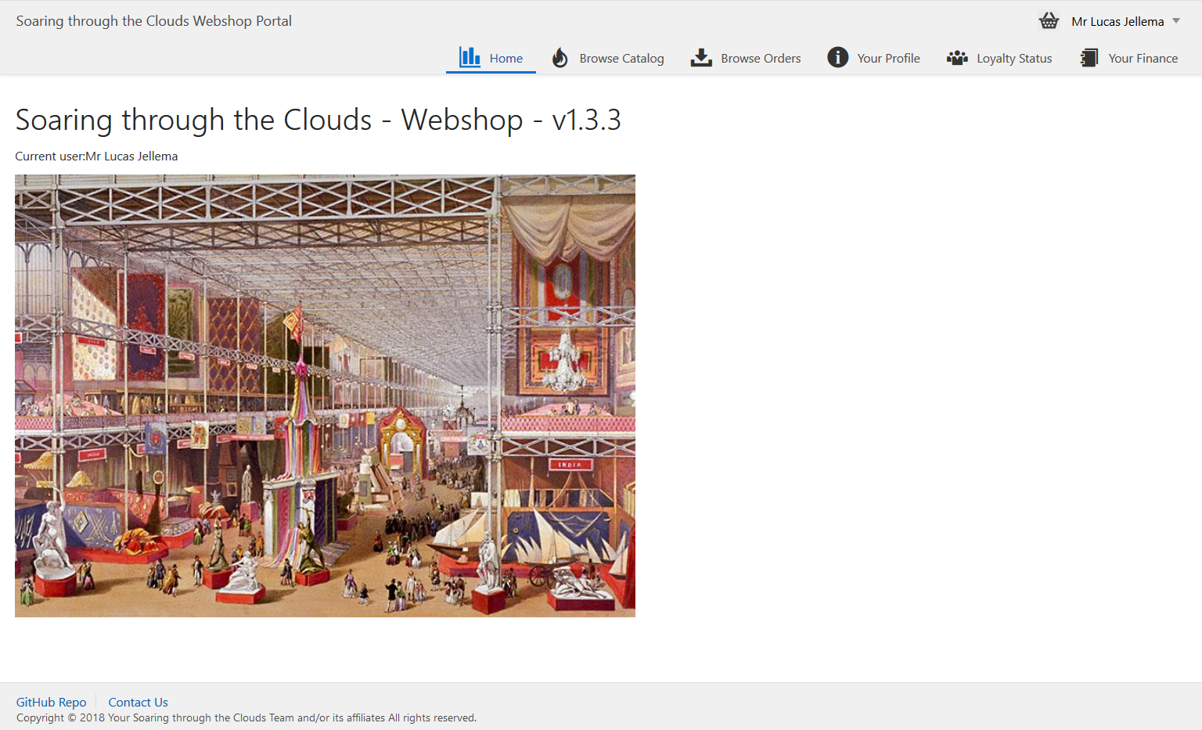
Demo of Referencing JET Web Components
jwcm
(JET WebComponent Manager CLI)
jet-composites.json
name: Comp1
version : >= 1.2
commit: <git commit>
url : <github repo url>
phase : design
name: Comp2
version : 1.0
url : <showroom>
phase : deploy
name: Comp3
branch: master
url : <github repo url>
phase : runtime
name: Comp4
url : <live app url>
phase : request

Slide 24
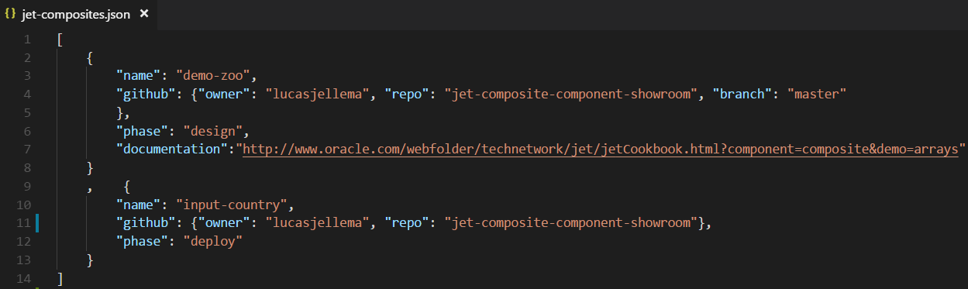
Configuration file to describe dependencies on JET Web Components
The GitHub reference is provided as source for the JET Web Components

Slide 25
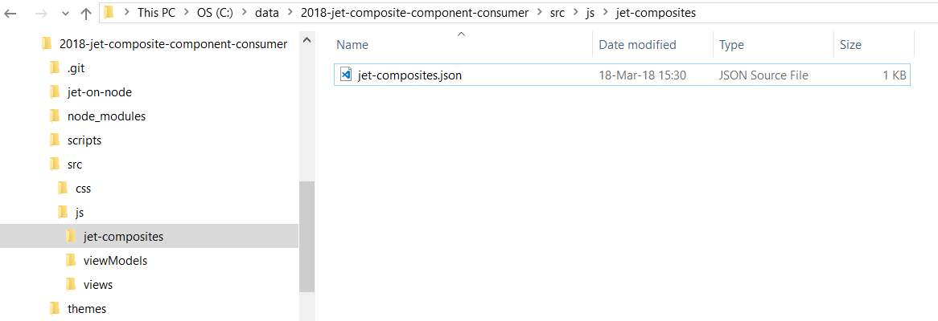
Prior to running JWCM (JET WebComponent Manager)

Slide 26
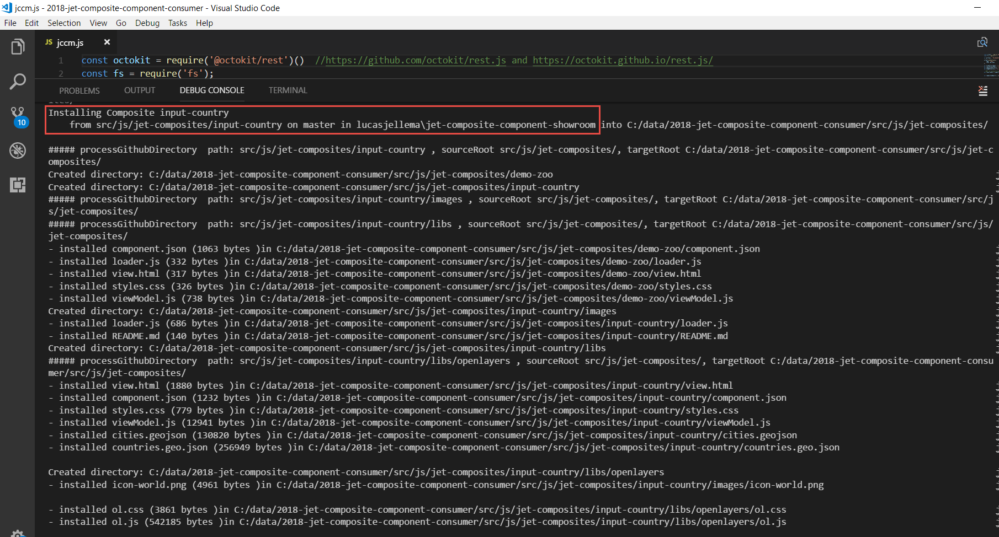
Run JWCM (design time)

Slide 27
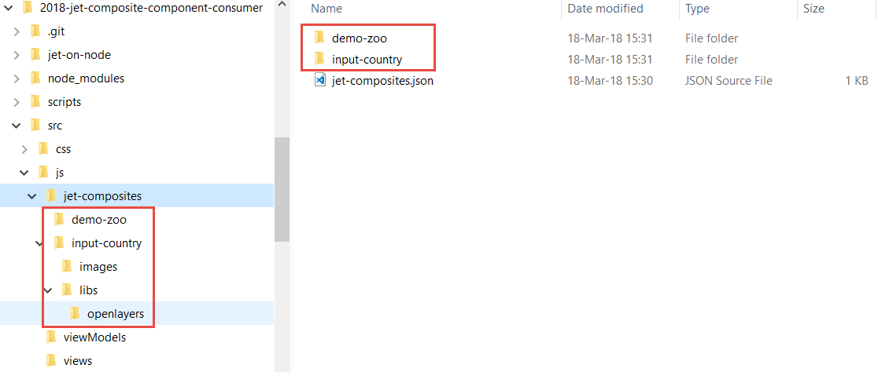
When JWCM is done
All resources for the specified JET Web Components were installed
Note: jwcm can be re-run – to bring in the latest definition of the JET Web Component

Slide 28
The application is running in a live environment (for example Oracle Application Container Cloud)
Note the hover text shown for the globe image

Slide 29
Click on country

Slide 30
Wikipedia details for newly selected country are shown in an IFRAME

Slide 31
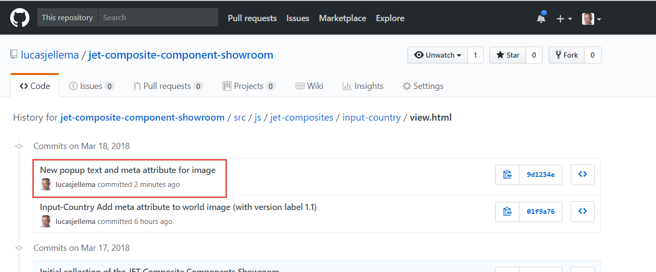
The sources of the input-country component were updated and pushed to the GitHub repository
The new version has a new text for the hover message for the globe icon
Note: currently these sources are not live anywhere

Slide 32
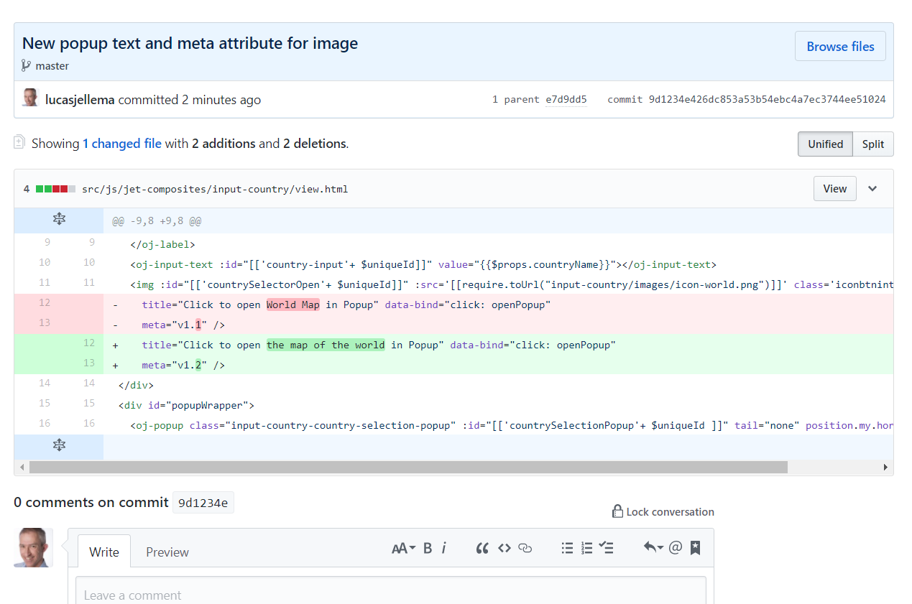
Detailed changes in JET Web Component

Slide 33
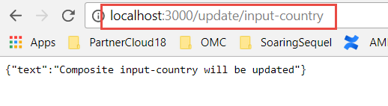
Refresh the JET Web Component in the live application
By sending a GET request to the endpoint /update/input-country the JET application is instructed to refresh the composite component from the GitHub source defined in jet-composites.json

Slide 34
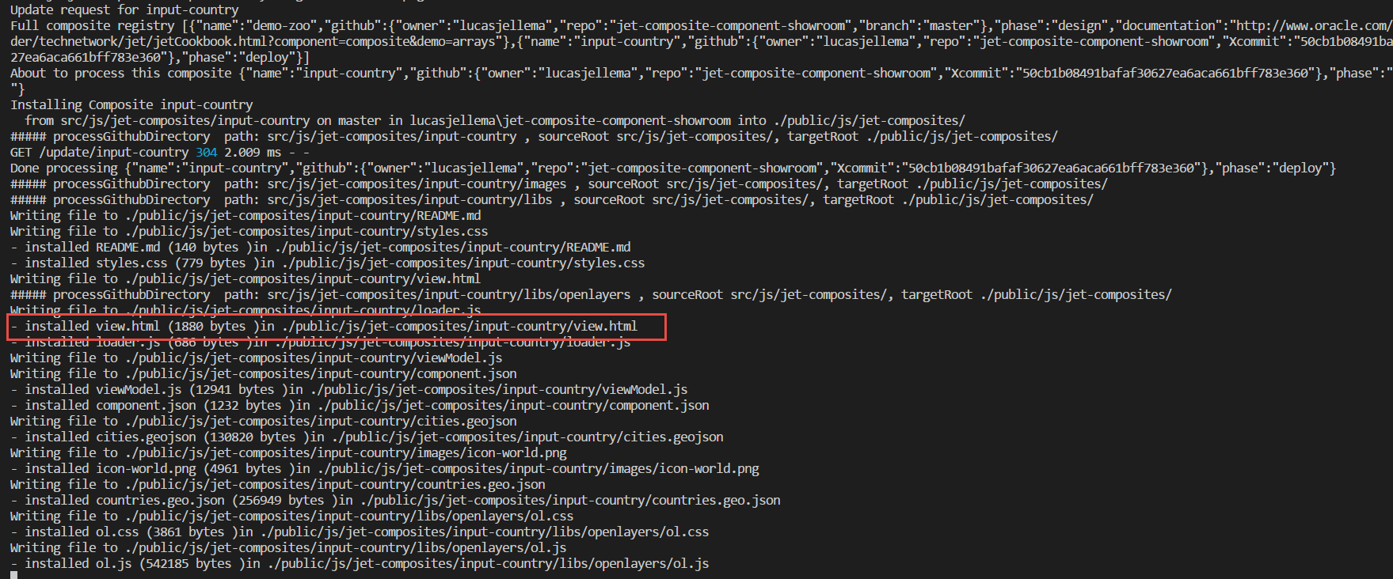
Server side logging for update of JET Web Component

Slide 35
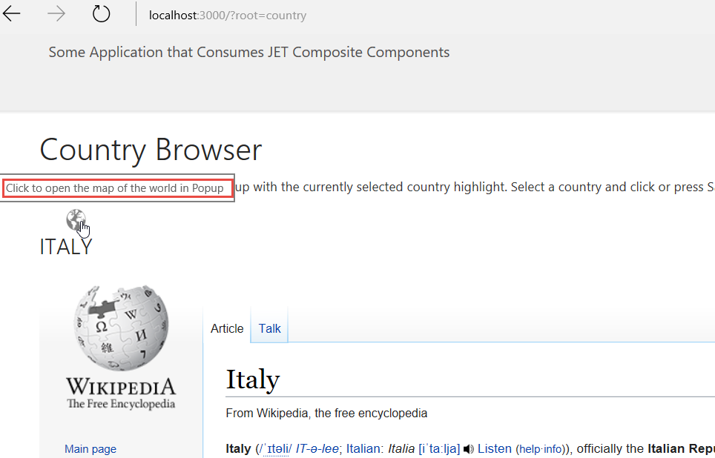
Without redeploying the application – the new version of the JET Web Component is live

Slide 36
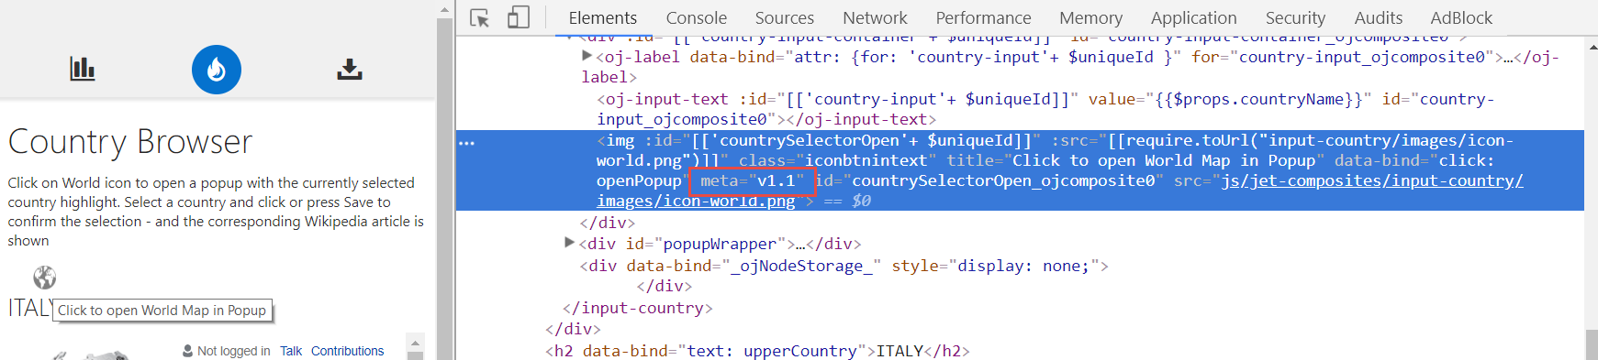
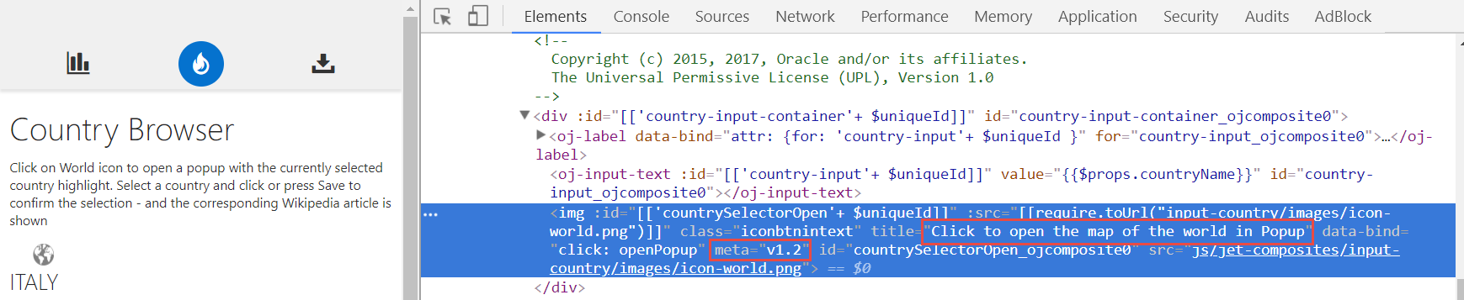
Without redeploying the application – the new version of the JET Web Component is live
Before:
After:

Slide 37
Trigger from GitHub WebHook
Create an endpoint in the Node application that serves JET to handle the WebHook event
Check if Push includes Commits that have updated any aspect of the JET Web Components we are interested in
If so, update these Composite Components
Configure a webhook in GitHub for the push event

Slide 38
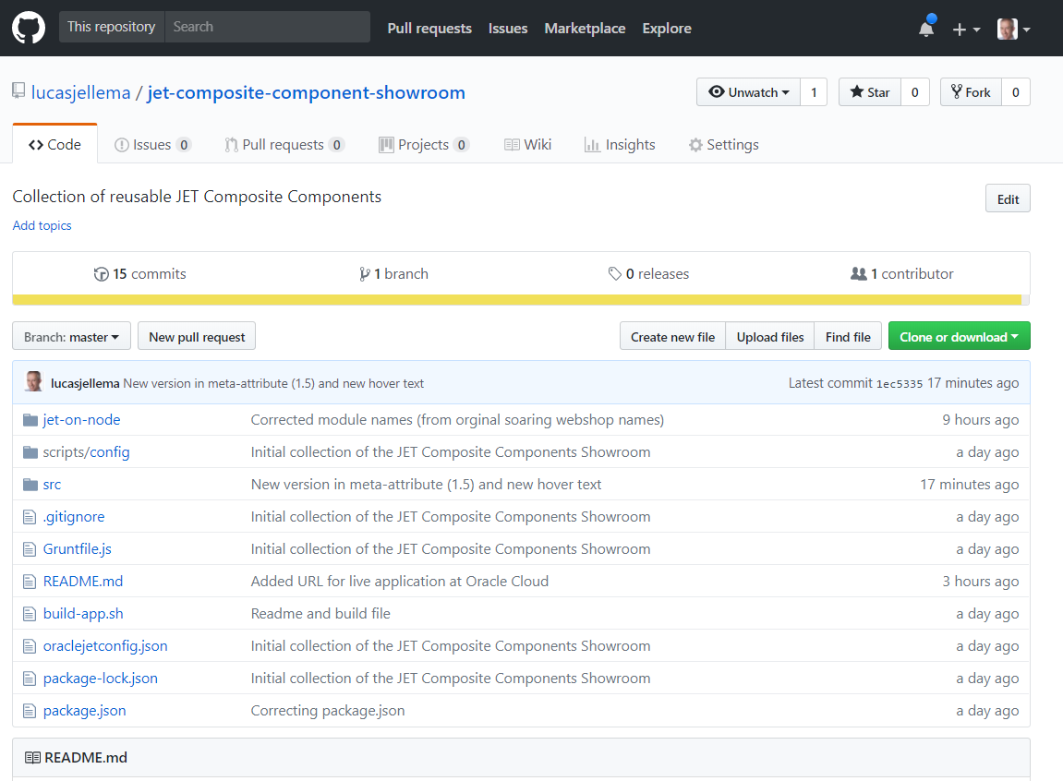
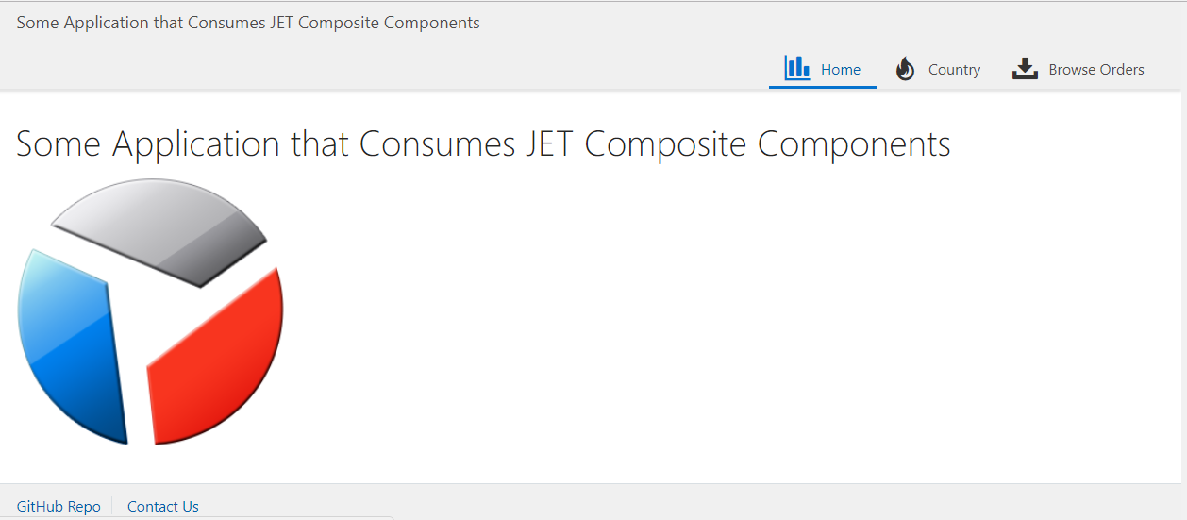


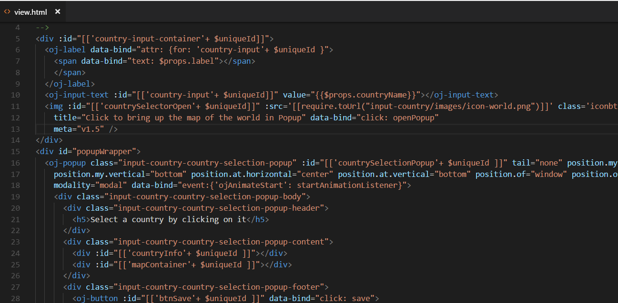
From developer’s commit & push to updated live application
4
2
Commit & push
3
WebHook Push
1
API <public>, /update, /github/push
Fetch and Write updated JET Web Component Sources
jwcm
JET sources

Slide 39
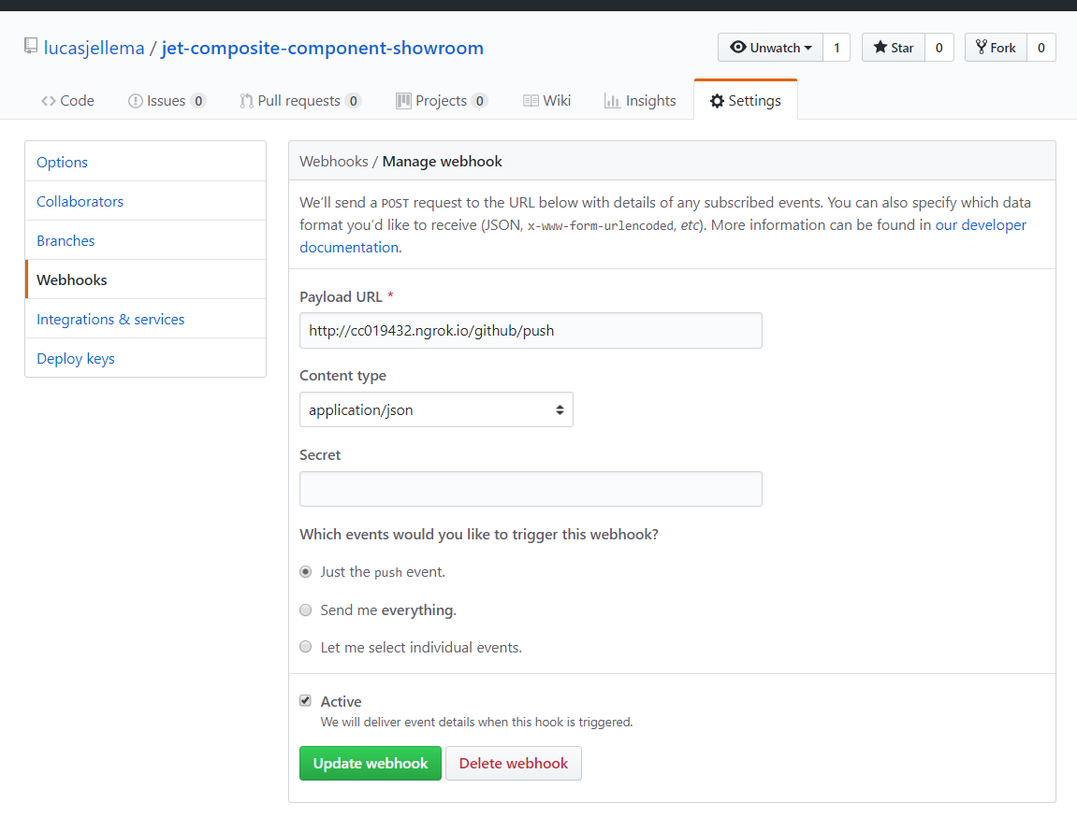
Configure WebHook for GitHub Repo that contains sources for JET Web Component(s)

Slide 40
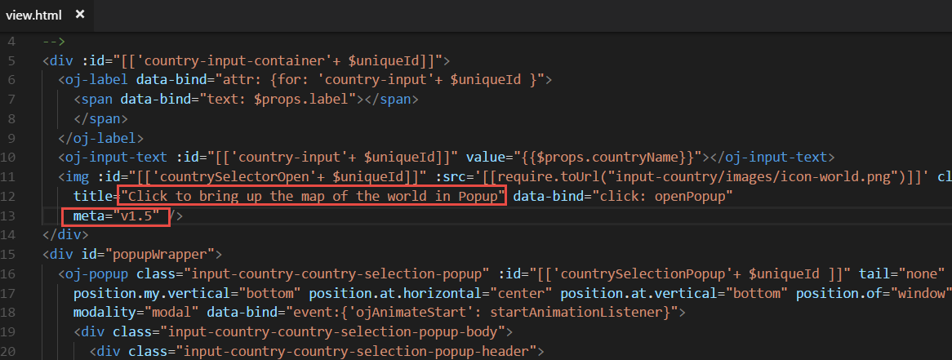
Make change – and commit and push

Slide 41
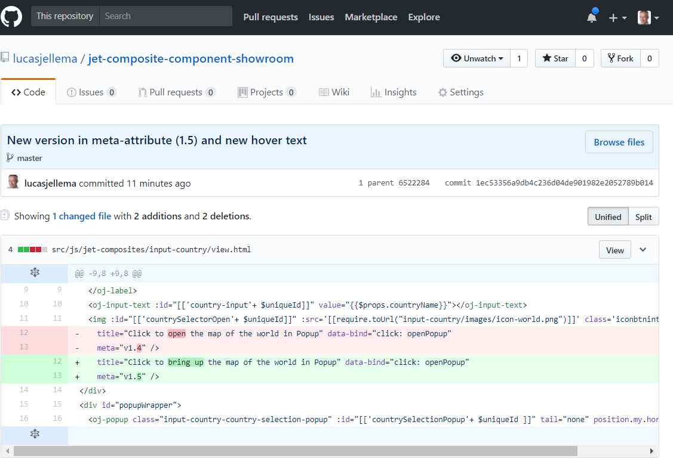

Slide 42
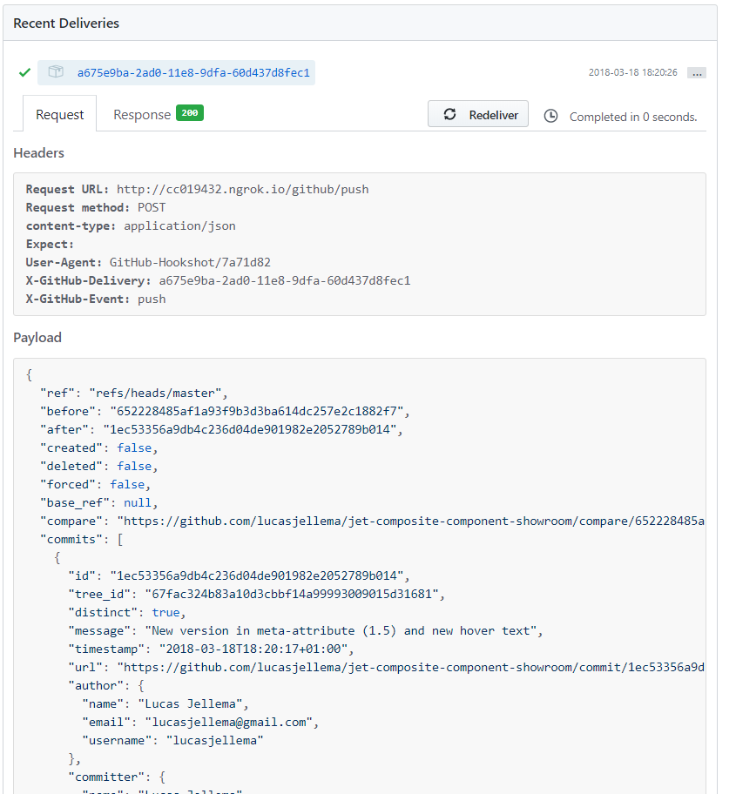
The GitHub Push Event that was sent

Slide 43
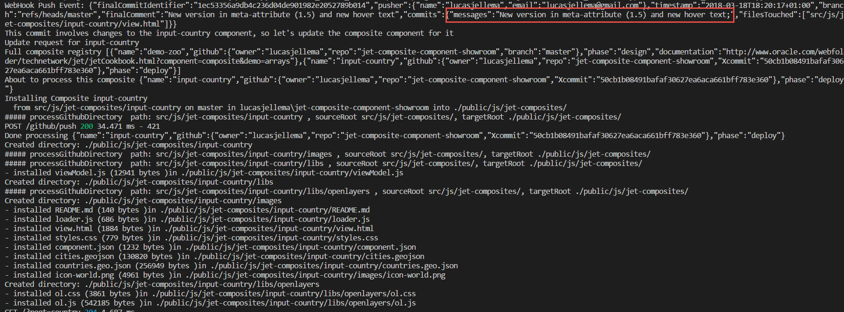
WebHook pushes event to Node application
Based on the info in the push event, it is decided that the input-country component should be refreshed

Slide 44
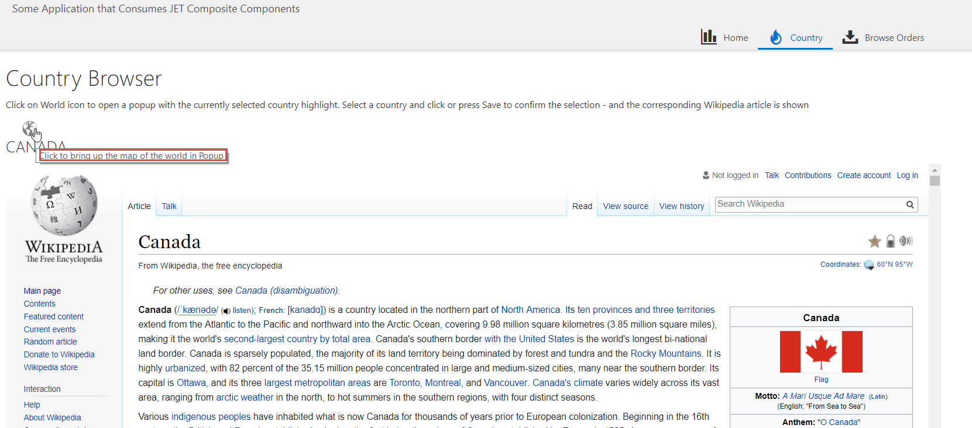
After a browser refresh – the changes are now live

Slide 45
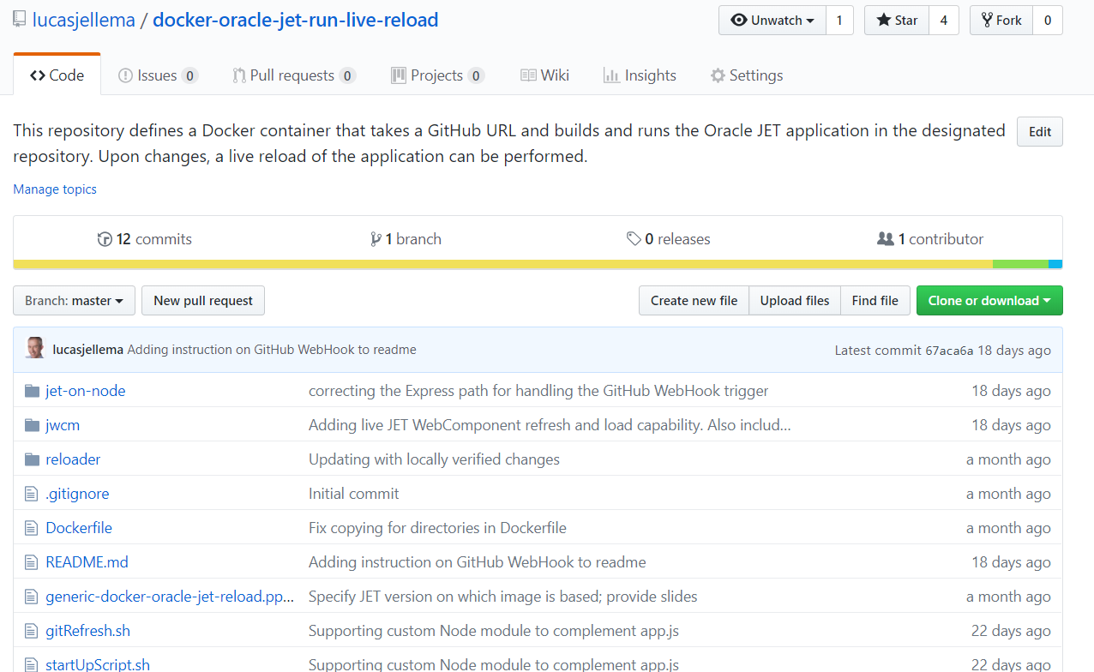
JWCM and Docker Container for JET with live reload
https://github.com/lucasjellema/docker-oracle-jet-run-live-reload

Slide 46
JET WebComponents and Microservices Architecture - decoupled development, composing at build, deploy or even runtime

Slide 47

Microservices style
Agile DevOps: flexible, fast, low effort, low risk, quick roll out
Breaking product into small (not too complex) pieces – each owned by a DevOps Team
Stand-alone, independent, encapsulated
Well defined interfaces for controlled interactions – preferably asynchronous (event based)
What about the User Interface?
When put before end-users: all UIs should be fused into one UX
How/when? Develop as one?
Merge at design | build | deploy | run time?

Slide 48
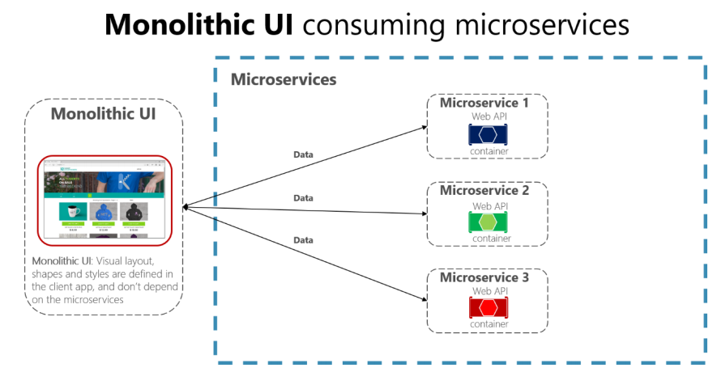
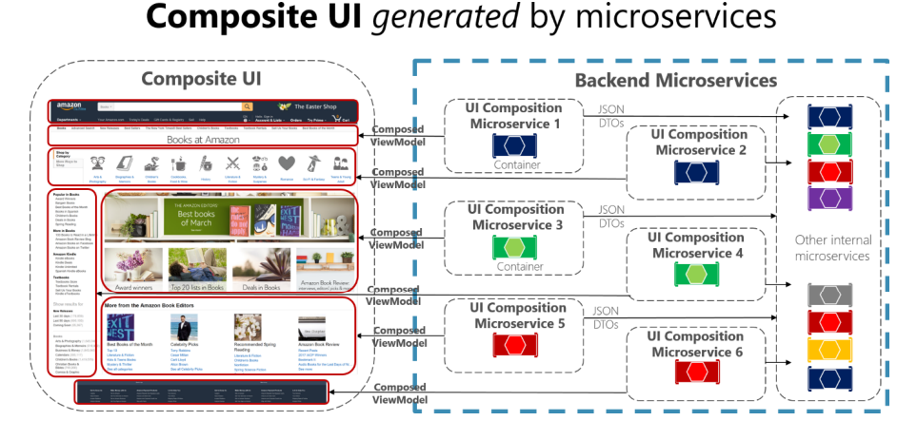
Microservices Architecture - User Interface
Is UI part of Microservice?
VS.
Notes:
spend a little time on microservices - why decided to apply a microservices architecture (objectives, expectations) and how we designed the architecture in our case (link to Omesa?). What were the rules and assumptions. Here we can perhaps show how we use Slack and GitHubExplain in some details what important role events played. Maybe at that point also discuss the workflow (@Luis Weir’s article and our discussions around that).Perhaps we can use the Event Monitor Dashboard (that shows all on EventHub/Kafka events on a timeline ) to illustrate the story on the events (and the Order workflow)

Slide 49
User Interface in a Microservices architecture
Web Shop Portal
µ Customers
µ Orders
µ Products
µ Loyalty
µ Finance
µ Logistics
µ Customers
µ Orders
µ Products
µ Loyalty
µ Finance

Slide 50


Web Shop Portal Solution Design – decoupled IFRAME based microservice front-ends
Web Shop – Customer User Interface
CustomerSignIn,
ChangedProfileSettings
Client Side (JS) Event Bus & Routing
Context (user settings, navigation history, ..)
Menu & Nav
Marketing content
IFRAME
IFRAME
ViewProduct
InspectInvoice
IFRAME
IFRAME
IFRAME
AddToBasket
API Gateway
µ Customers
µ Orders
µ Products
µ Loyalty
µ Billing & Invoicing

Slide 51
Web Shop Portal Solution Design – decoupled JET Web Components – much smoother UX!
Web Shop – Customer User Interface
CustomerSignIn,
ChangedProfileSettings
Client Side (JS) Event Bus & Routing
Context (user settings, navigation history, ..)
Menu & Nav
Marketing content
Module
Module
ViewProduct
InspectInvoice
IFRAME
Module
Module
AddToBasket
JET Web Component
JET Web Component
JET Web Component
JET Web Component
API Gateway
µ Customers
µ Orders
µ Products
µ Loyalty
µ Billing & Invoicing

Slide 52
WebShop Portal Solution Design – loading microservice frontends into a mash-up User Interface
Web Shop – Customer User Interface
CustomerSignIn,
ChangedProfileSettings
Client Side (JS) Event Bus & Routing
Context (user settings, navigation history, ..)
Menu & Nav
Marketing content
Module
Module
IFRAME
Module
Module
JET Web Component
JET Web Component
JET Web Component
JET Web Component
build
runtime
Deploy & Live refresh
deploy
Load JET Web Components

Slide 53
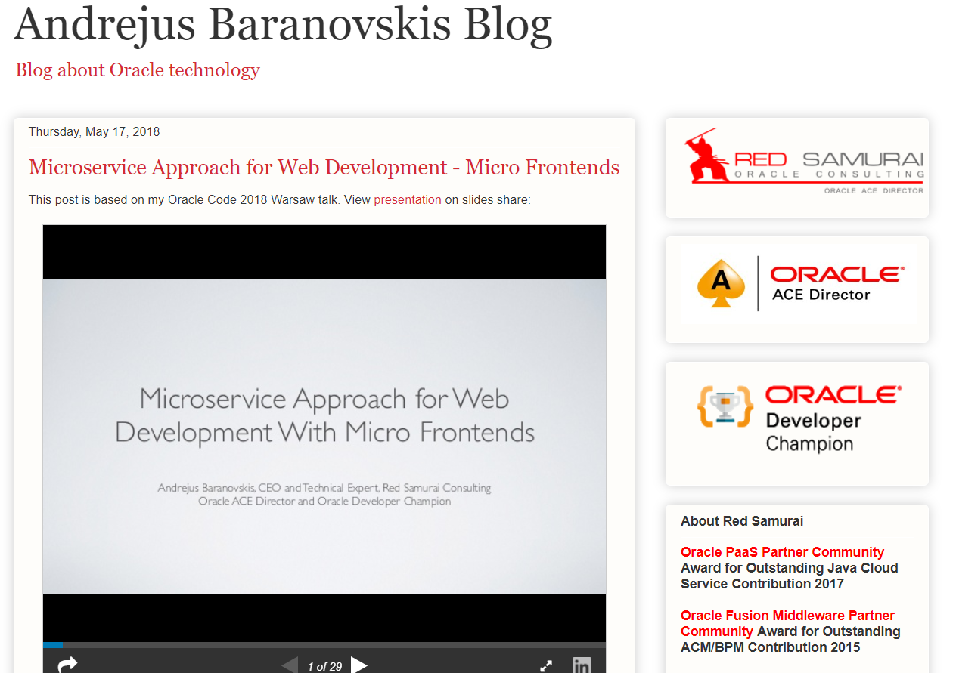
http://andrejusb.blogspot.com/2018/05/microservice-approach-for-web.html
Notes:
http://andrejusb.blogspot.com/2018/05/microservice-approach-for-web.html

Slide 54
Creating a JET WebComponent

Slide 55
Constitution of a JET Web Component
JET
Web Component
UI (HTML + CSS)
Events, Property Updates, Function calls

Slide 56
Constitution of a JET Web Component
JET
Web Component
UI (HTML + CSS)
loader.js
view.html
Events, Property Updates, Function calls
component.json
styles.css
Other Resources
viewModel.js

Slide 57
Constitution of a JET Web Component
Property values (can be Observables and callback functions), Function Calls
JET
Web Component
UI (HTML + CSS)
loader.js
view.html
Events, Property Updates, Function calls
component.json
styles.css
Other Resources
viewModel.js

Slide 58
Creation of a component
Identify scope of the component
Create a regular JET application (ojet)
Generate a composite component (ojet)
Identify and separate two areas
Test bed, sandbox – used for development & test
Composite Component
Iteratively
Configure & Describe
Develop
Test
Publish ( => Consume – many times)
ViewModel
Web Component
View
Sandbox JET Application

Slide 59
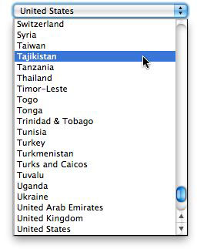
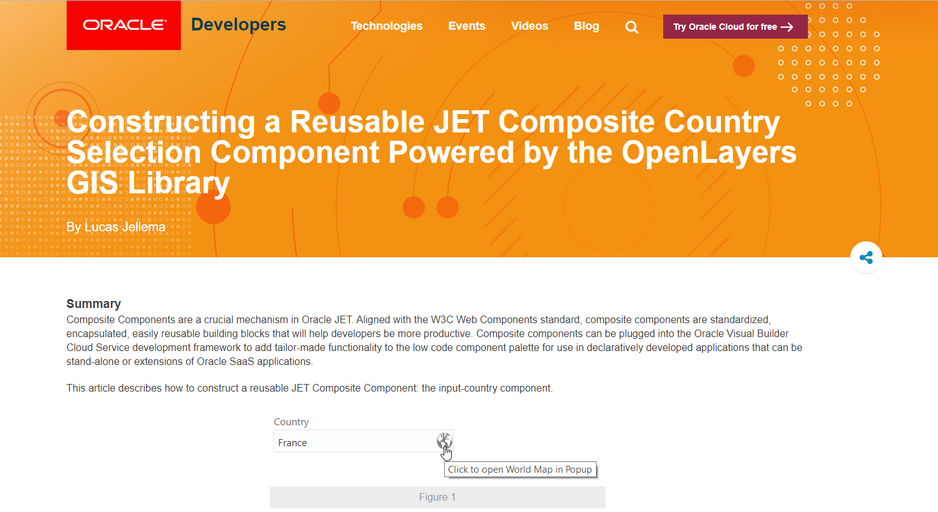
Develop Input Country Component
Scope: display and select country on a map
Zoom, pan, ..
To be used instead of these horrible dropdown lists
Later: possibly extend with selection of
multiple countries
Regions, cities
https://developer.oracle.com/javascript/reusable-jet-composite

Slide 60
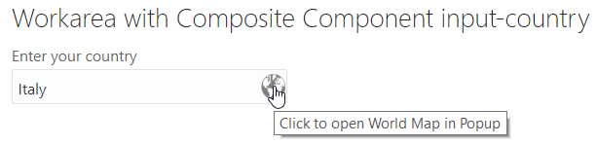
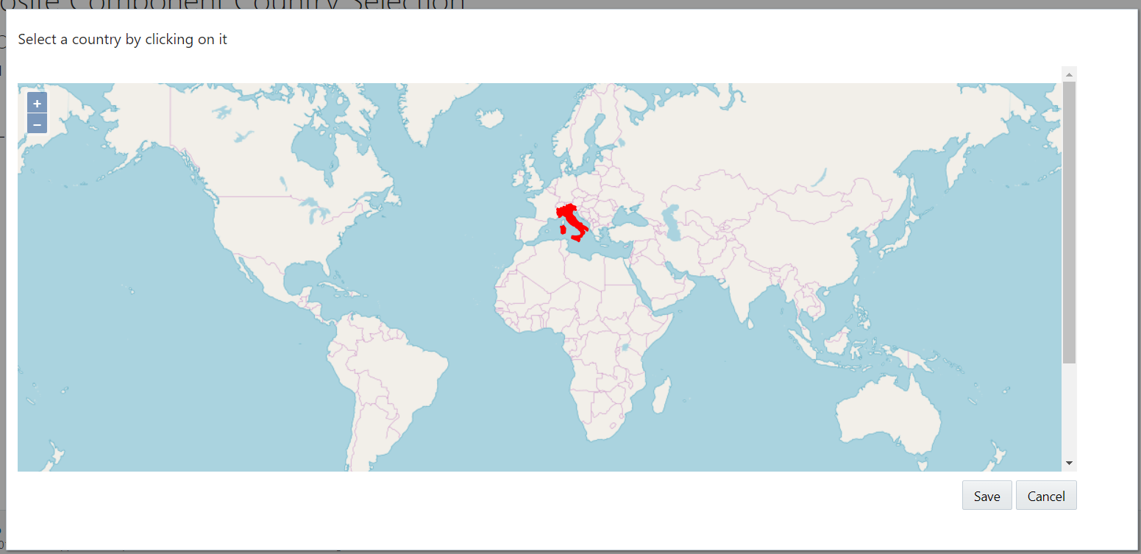

Slide 61
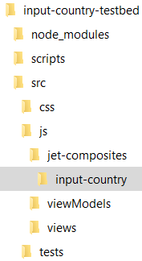
Input Country
Create a regular JET application input-country-testbed with ojet CLI
It will contain the Web Component as well as a single View & ViewModel
Generate Web Component input-country with the ojet CLI
Identify and separate two areas
Test bed– used for development & test
Web Component
Iteratively
Configure & Describe
Develop
Test
Publish
ViewModel
input-country
Web Component
publish
View
input-country-testbed

Slide 62
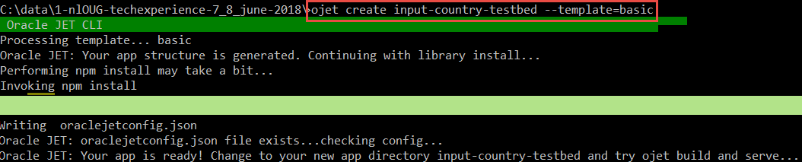
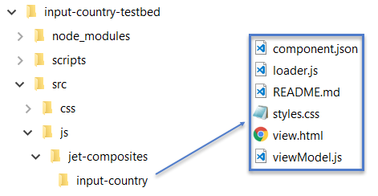
Generate Sandbox JET application and the skeleton JET Web Component

Slide 63
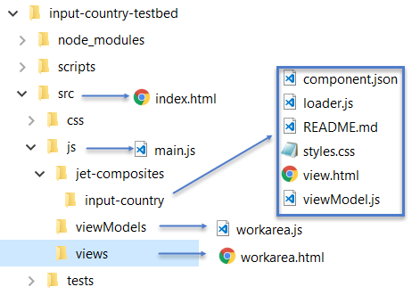
Prepare test bed
Create directory src/js/views
And file workarea.html
Including the <input-country> tag
Create directory src/js/viewModels
And file workarea.js
With references to composite component input-country
Include reference to module workarea in index.html
Include reference to ojModule in main.js
Run testbed application with ojet serve

Slide 64
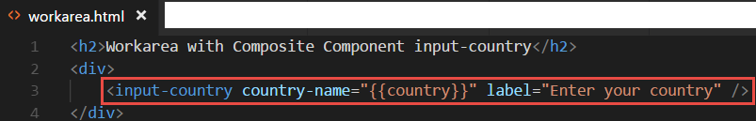

Prepare test bed
Workarea.html
Including the <input-country> tag
Workarea.js
With references to web component input-country

Slide 65


Prepare test bed
Include reference to module workarea in index.html
Include reference to ojModule in main.js
Run testbed application with ojet serve

Slide 66


Define a property for the component and make it display something
Define property countryName in component.json
Use value of property in output rendered by the component

Slide 67



Set property in test bed application

Slide 68

Show world map with country highlighting & selection
Notes:
Leverage the world wide community

Slide 69

Introducing OpenLayers (open source, HTML5, JavaScript)
Notes:
Examples: http://openlayers.org/en/latest/examples/
API: http://openlayers.org/en/latest/apidoc/
Quickstart: https://openlayers.org/en/latest/doc/quickstart.html
On Line Editor: http://programmerg.github.io/ol3editor/

Slide 70

OpenLayers - Summary
Initial release: 2006
Most recent release: 5.2.0, August 2018
Since 2007 under Open Source GeoSpatial Foundation (OSGeo)
Originally based on Prototype JavaScript Framework; still fully (client side) JavaScript
Support for GeoRSS, KML (Keyhole Markup Language), Geography Markup Language (GML), GeoJSON and map data from any source using OGC-standards as Web Map Service (WMS) or Web Feature Service (WFS).
Map sources include Bing, Open Street Map, MapBox, Stamen, ArcGis (Esri)
Notes:
https://en.wikipedia.org/wiki/OpenLayers
https://en.wikipedia.org/wiki/Open_Source_Geospatial_Foundation
https://en.wikipedia.org/wiki/OpenStreetMap
Sites using OpenLayers: https://www.wappalyzer.com/technologies/openlayers

Slide 71


Hello World Map
Notes:
https://openlayers.org/en/latest/doc/quickstart.html

Slide 72


Add OpenLayers to JET Web Component
Copy OpenLayers libraries into jet-composites/input-country/libs
Include OpenLayers resource in loader.js

Slide 73

Add OpenLayers to JET Web Component (2)
Reference module input-country/ol in viewModel.js in order to leverage the OpenLayers JavaScript objects

Slide 74


Show OpenLayers map in Web Component

Slide 75


Slide 76
Output from a Component
UI (HTML + CSS)
JET
Web Component
Property values (can be Observables and callback functions), Function Calls
Set Observable, Callback function
Events, Property Updates, Function calls
(be inspected from the consuming application)
(publish event explicitly on client side event bus)

Slide 77

Define component output in component.json
Writable property
Callback function
Event

Slide 78

Publish output from input-country component
Publish Event
Set writable property
Invoke Callback function

Slide 79

Leverage output in consuming application
Callback function
Observable, writable property
Event Handler

Slide 80

Handling Component Output in Consuming Application
Observable, writable property
Callback function
Event Handler

Slide 81
Publishing a JET Web Component

Slide 82

Publishing of JET Web Component
Ensure properly documented
Comments in …
Additional instructions/documentation
Setup governance
Ownership, support, change process (breaking & backwards compatible)
It is like releasing a product!
Zip it up and distribute it
Commit to Git repo
Possibly public repository [in GitHub]
Add to JET Web Component Exchange

Slide 83
Let’s Share!

Slide 84


JET Web Components and Visual Builder Cloud

Slide 85

JET Web Components and Visual Builder Cloud
Visual Builder Cloud is semi-low code development & runtime environment
Aka browser based JET IDE in the cloud
Visual Builder supports visual & declarative development
As well as high coding
Visual Builder provides all JET assets out of the box
Ready for drag & drop, property palette style configuration – and straightforward coding with copy/paste, code completion, …
JET Web Components can be imported into Visual Builder
Custom JET Web Components can be made available for “visual builders”
These custom components are treated like regular JET components by IDE – visual editor, property palette, coding editor etc.

Slide 86
Summary
JET Web Components are good:
Reuse
Productivity
Best practices
Clean design, well organized development
The spirit of microservices – or even the actual microservice front end
JET Web Components are straightforward
Create them like small, structured, well documented JET applications
Use them by copying a zip, configuring some properties and embedding in a view
JET Web Components can be used in Oracle Visual Builder Cloud
I envision (or at least hope for) a world with many shared community JET Web Components
Perhaps Using the JET Web Components Manager (jwcm) to manage components at design & run time

Slide 87
Some resources
Article: https://developer.oracle.com/javascript/reusable-jet-composite
GitHub Resources:
https://github.com/lucasjellema/jet-composite-component-showroom
https://github.com/lucasjellema/input-country-composite-component
https://github.com/lucasjellema/oracle-jet-web-component-manager

Slide 88





Thank you Dank je wel
Blog: technology.amis.nl
Email: lucas.jellema@amis.nl
: @lucasjellema
: lucas-jellema
: www.amis.nl, info@amis.nl
https://github.com/lucasjellema/jet-composite-component-showroom
https://github.com/lucasjellema/input-country-composite-component

